Slide 1
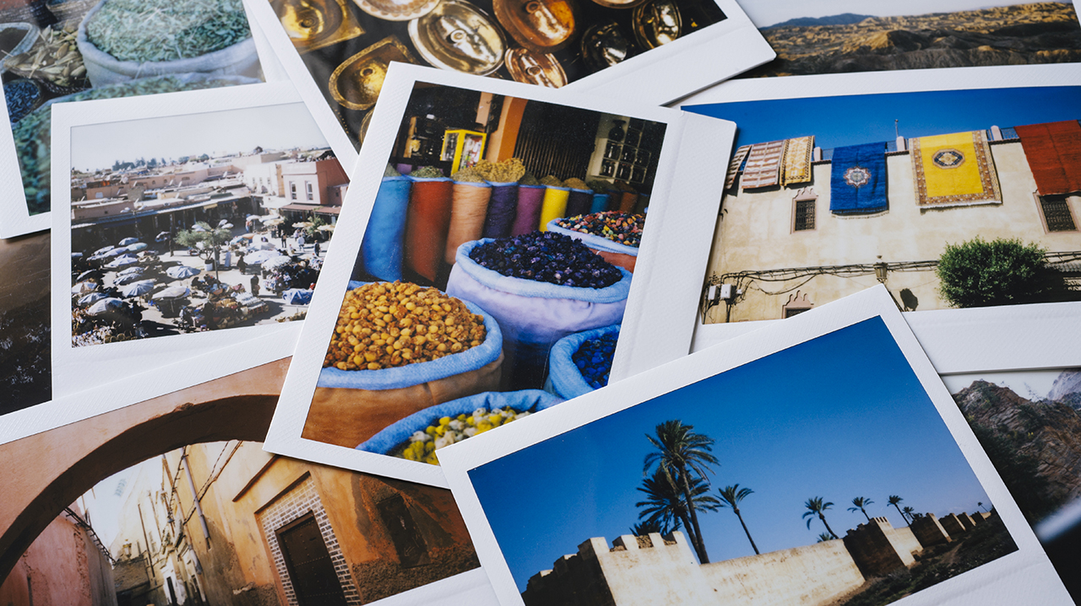
i
Preparation in my country and abroad
In my country:
Research and Planning
Travel Documents
Health Preparations
Finances
Packing
Security
Abroad:
Language
Cultural Etiquette
Technology
Transportation
Safety

Slide 2
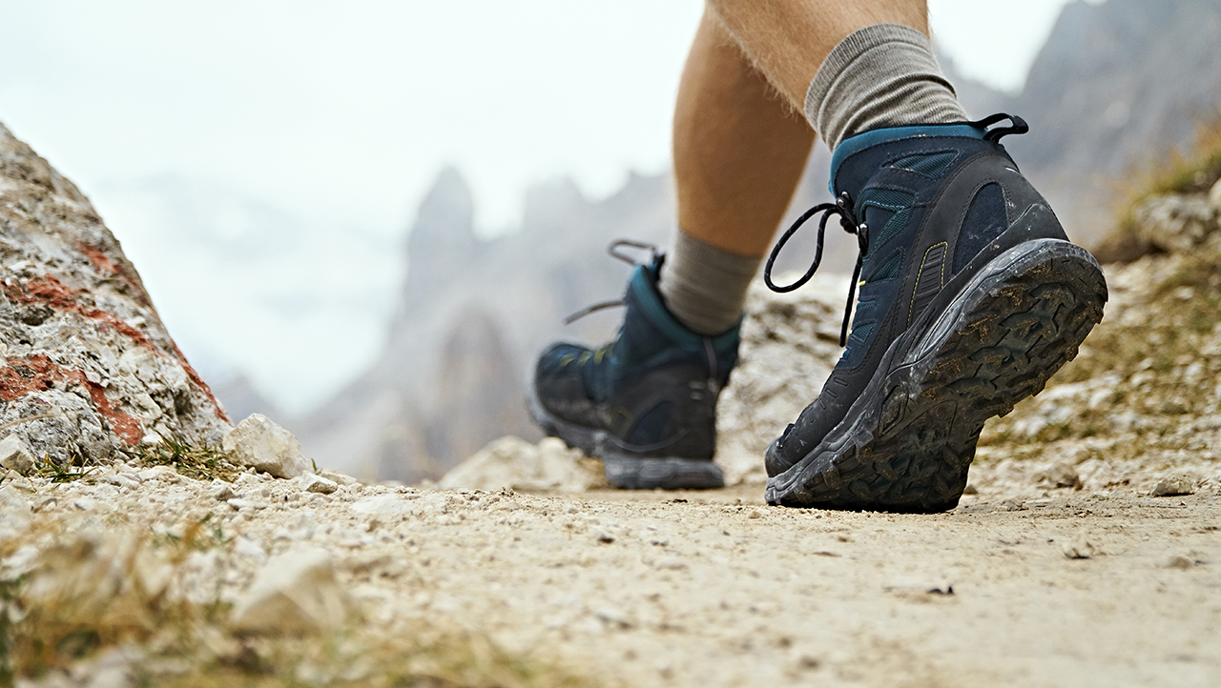
Travelling individually
Advantages:
Freedom and Flexibility
Decision-Making Control
Budget Control
Disadvantages:
Loneliness
Safety Concerns
Costs

Slide 3

Travelling in a group
Advantages:
Safety in Numbers
Cost Savings
Logistical Ease
Disadvantages:
Potential for Conflict
Waiting and Coordination
Less Cultural Immersion

Slide 4
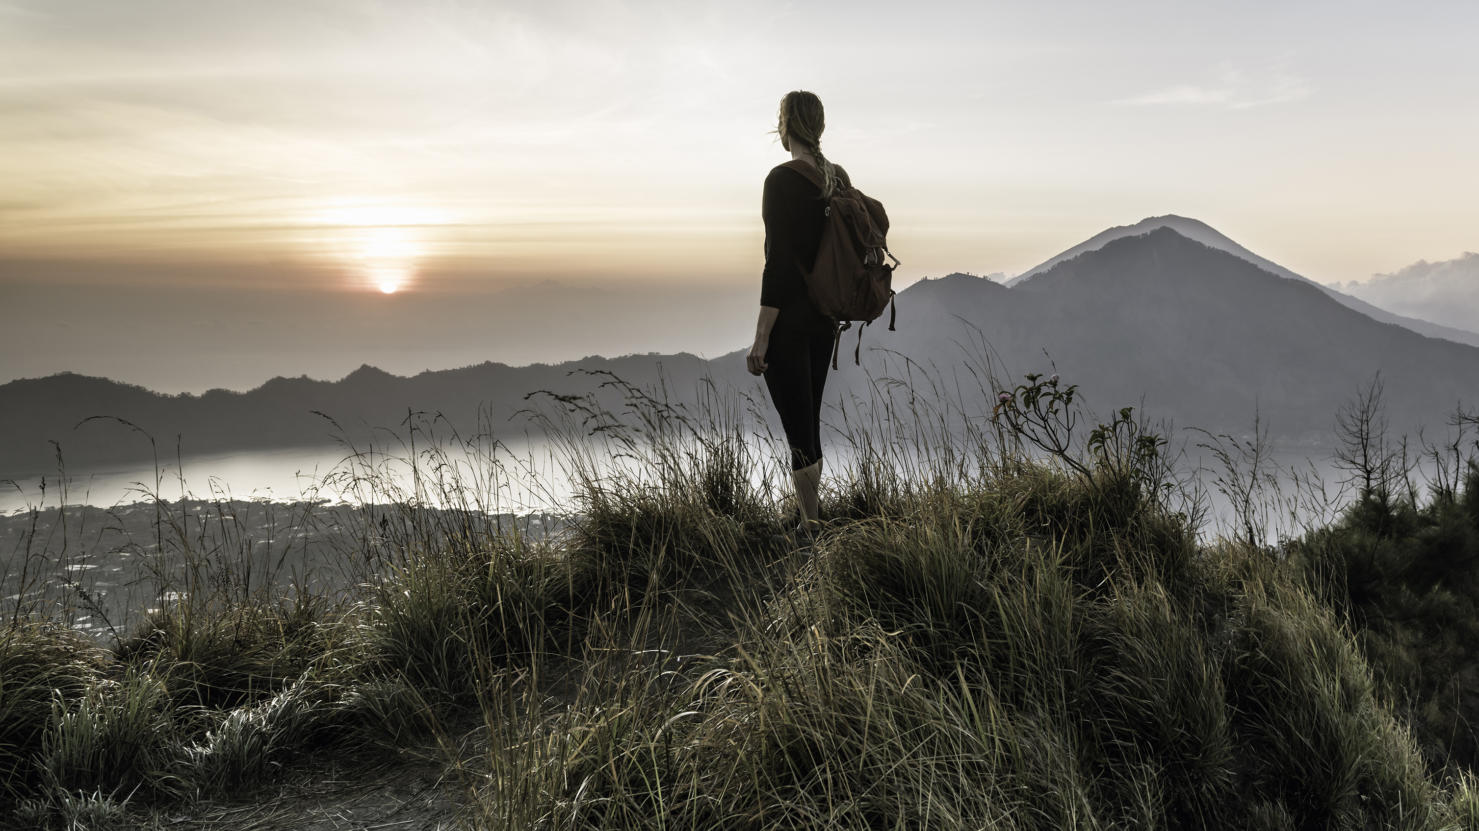
Spanding your holiday in your country
Advantages:
Familiarity
Cost Savings
Support Local Economy
Disadvantages:
Potential for Routine
Less Adventure
Weather Constraints

Slide 5
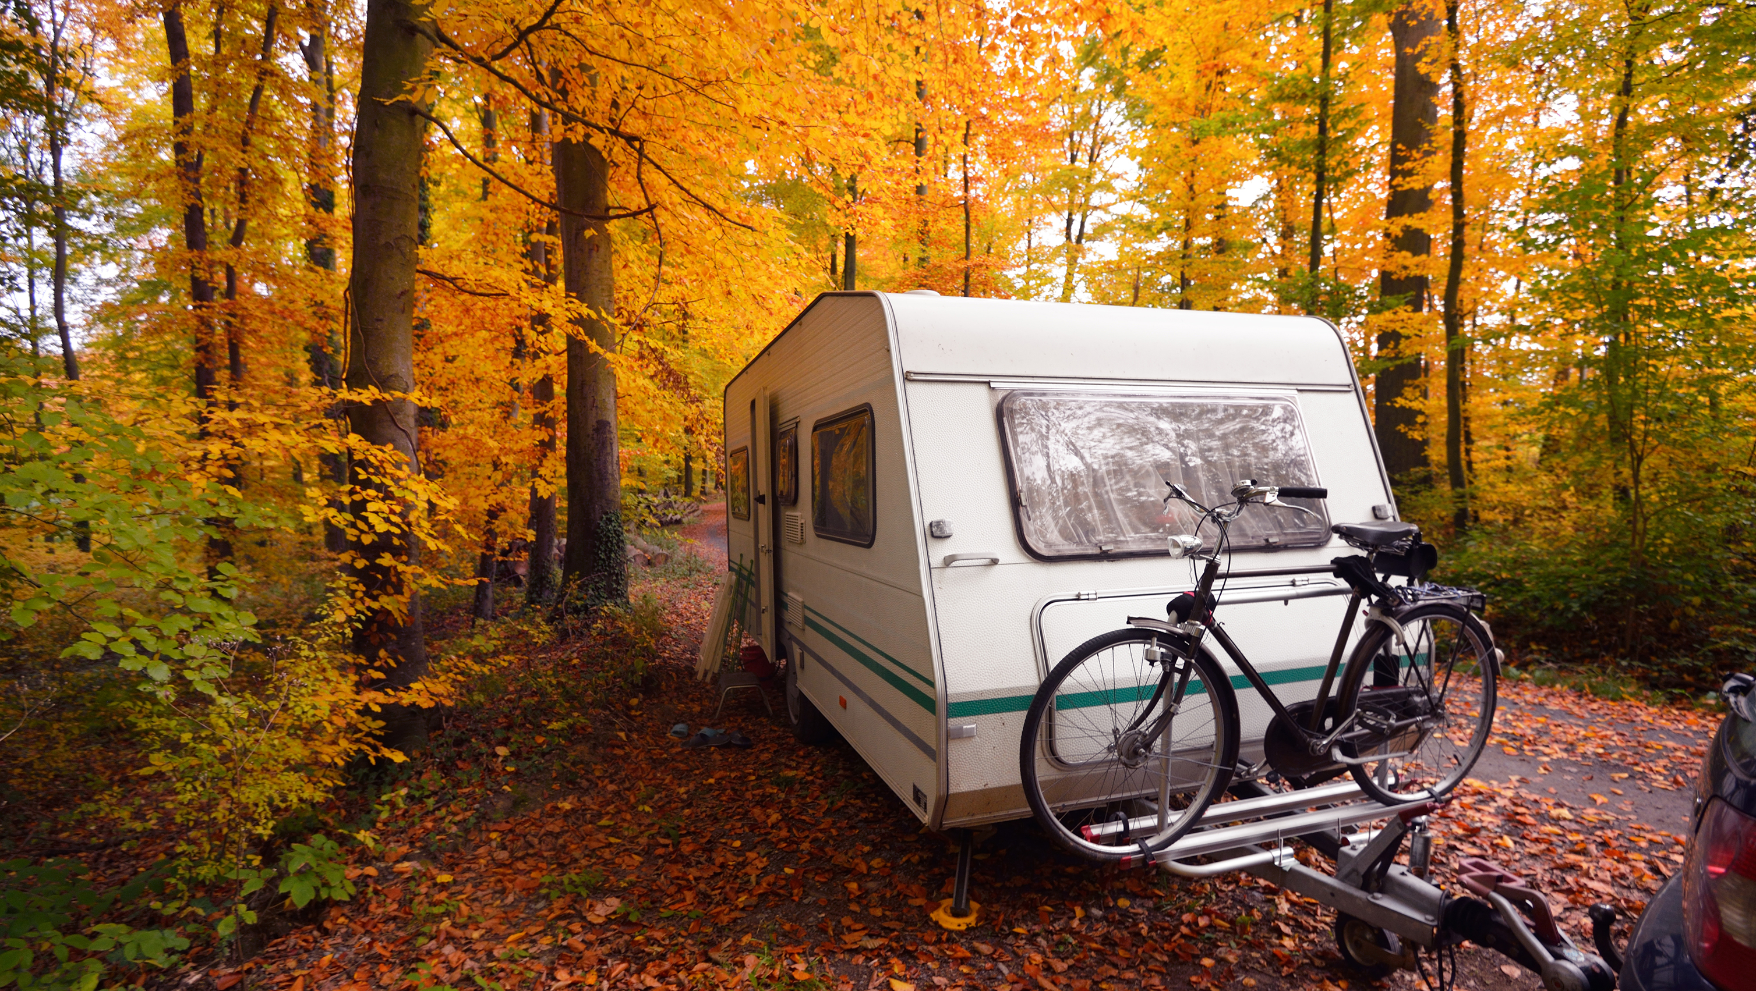
Travelling abroad
Advantages:
Cultural Exposure
Adventure and Novelty
International Cuisine
Disadvantages:
Costs
Language Barriers
Safety Concerns

